Slide 1


Sinhgad Academy of Engineering Department of Information Technology
Academic Year 2025-26
Academic Year 2025-26
BE Project review No : 2
ManaSarathi AI-Powered Mental Wellness Platform with Holistic Healing and Emotional Support
By :
Project Group No : 06
Aditya Shirsat (ITBA70)
Atharva Lole (ITBA65)
Sourabh Shirkande (ITBA67)
Neha Kamble(ITBA18)
Guide: Prof. M . S . Kale
Reviewer : Prof. R. R. Yadav
1

Slide 2
Index
Introduction
Aim And Objective
Scope
Literature Survey
Problems Identified
Proposed System/Solution
Objective Finalized
Dataflow Diagram
UML Class Diagram
Sequence Diagram
Architecture Diagram
Software / Hardware
Project Plan
Conclusion
References

Slide 3
Introduction
Introduction:
Mental health issues such as anxiety, depression, stress, and emotional imbalance are on the rise, especially in fast-paced, technology-driven lifestyles. Many people lack easy access to professional help, while others prefer self-paced, private wellness solutions. Our AI-Powered Mental Wellness platform bridges this gap by combining modern psychological practices with ancient wellness techniques to guide users toward improved mental and emotional health.

Slide 4
AIM AND OBJECTIVE
Aim:
To create an AI-driven web application that assesses, guides, and supports users in improving their mental wellness using a blend of Western therapy and Eastern wellness approaches.
Objectives:
To develop an AI-powered platform that provides personalized emotional and mental wellness support.
To integrate holistic healing practices like meditation, mindfulness, and stress management.
To design an empathetic chatbot capable of understanding and responding to human emotions.
To monitor users’ mood patterns and offer data-driven wellness recommendations.
To ensure privacy, safety, and ethical use of AI in mental health assistance.
To offer a 24/7 mental wellness companion with integrated progress tracking and content delivery.

Slide 5
SCOPE
WHO (World Health Organization) reports 1 in 8 people live with mental disorders; early detection improves outcomes.
AI chatbots (e.g., Woebot, Wysa) have shown positive impact in reducing symptoms of anxiety and depression.
Ancient practices like Yoga and Meditation have proven benefits for stress reduction and emotional stability.
Hybrid approaches combining digital CBT (Cognitive Behavioral Therapy) and mindfulness show improved engagement and results.
  Helps users facing mild to moderate emotional difficulties (not a clinical tool).
  Provides assessments (e.g., stress, anxiety, personality, trauma) and offers help based on test results.
  Leverages Eastern (yoga, meditation) and Western (therapy) methods.
  Works on mobile and web platforms.
  Ensures data privacy and ethical use of emotional information.

Slide 6
LITERATURE SURVEY
SR. NO | REFERENCE NAME | SEED IDEA / WORK DESCRIPTION | PROBLEM FOUND
1. | Jorge A. Ruiz-Vanoye et al. (2025), Artificial Intelligence and Human Well-Being: A Review of Applications and Effects on Life. | Reviews how AI influences life satisfaction through synthetic happiness, covering health, education, and social applications. | Lack of empirical evidence on long-term effects of synthetic happiness through AI.
2. | Anoushka Thakkar, Ankita Gupta, Avinash De Sousa (2024), Artificial Intelligence in Positive Mental Health: A Narrative Review | Explores AI's positive role in mental health such as diagnosis, emotional regulation, schizophrenia and neurodevelopmental disorders. | Existing AI models lack personalization and cultural sensitivity; ethical concerns raised.
3. | Zandra Bonnine V. Salcedo et al. (2024), Artificial Intelligence and Mental Health Issues | Narratively reviews AI’s support for mental health treatments, including tools used in different countries. | AI-based solutions are underutilized due to lack of technical infrastructure and ethical standards.

Slide 7
LITERATURE SURVEY
SR. NO | REFERENCE NAME | SEED IDEA / WORK DESCRIPTION | PROBLEM FOUND
4. | Anish Marade, Kartik Suvarna, Prasad Chaudhari, Vinita Bhandiwad, “Spiritual.AI: An AI-Driven Platform for Enhancing Mental, Emotional, and Spiritual Well-Being,” IJRASSET, Vol. 13, Issue IV, Apr 2025 | This paper introduces Spiritual.AI, a GPT-based AI platform providing personalized mental, emotional, and spiritual guidance. It integrates meditation, yoga, astrology, and productivity tools like the Pomodoro timer, combining ancient spiritual wisdom with modern AI for holistic well-being. | The system is conceptually strong but lacks large-scale implementation and real-world testing. Limited validation of AI’s effectiveness in handling deep psychological or spiritual issues.
5. | Kathleen Kara Fitzpatrick, Alison Darcy, Molly Vierhile, “Delivering Cognitive Behavior Therapy to Young Adults With Symptoms of Depression and Anxiety Using a Fully Automated Conversational Agent (Woebot): A Randomized Controlled Trial,” JMIR Mental Health, 2017. | This paper presents Woebot, an AI-powered conversational agent designed to deliver Cognitive Behavioral Therapy (CBT) techniques to young adults suffering from depression and anxiety. The chatbot interacts daily with users, offering emotional support and CBT-based mental health guidance. | The system focuses mainly on text-based CBT without deep personalization or spiritual integration. It lacks multimodal emotional recognition and adaptive therapy mechanisms.

Slide 8
PROBLEM IDENTIFIED
Limited access to affordable, quality mental health care.
Stigma around seeking professional therapy.
Overwhelming amount of unverified self-help content online.
Lack of personalized, culturally sensitive guidance.
Inability to track long-term progress in mental wellbeing.
Limited access to therapists, especially in rural areas

Slide 9
Objectives Finalized
Simple, quick onboarding process.
Multiple test options (personality, anxiety, stress, overthinking, trauma, emotional intelligence, etc.).
Three-path solution: Western, Eastern, or Hybrid approach.
AI-driven therapeutic conversations.
Curated, quality content recommendations.
Mood tracking and progress visualization.

Slide 10
Proposed System / Solution
User Sign-Up: Collect basic details (name, DOB, gender, contact info).
Initial Assessment: Short mental health screening (under 5 minutes).
Optional Deep Tests: Personality, anxiety, stress, etc.
AI Analysis: Processes test results to determine wellbeing state.
Recommendation Path: Western therapy, Eastern methods, or Hybrid.
Daily Support: Chatbot, guided practices, curated content.
Progress Tracking: Mood charts, engagement logs, reassessment prompts.

Slide 11
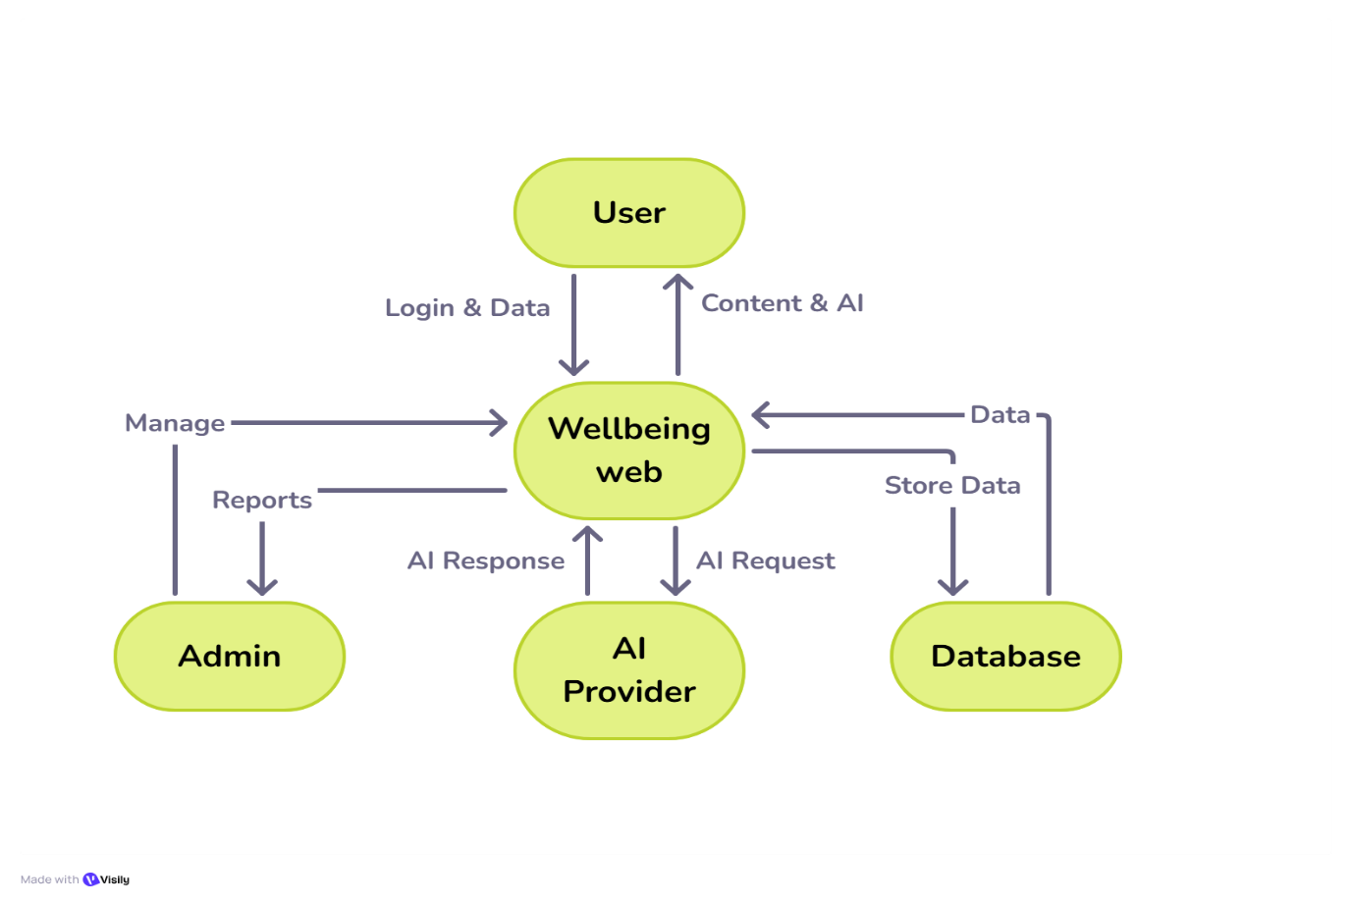
Data Flow Diagram
DFD Level 0:

Slide 12
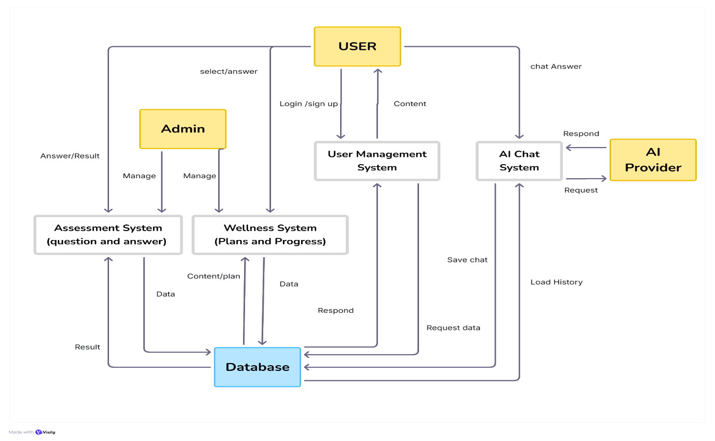
Data Flow Diagram
DFD Level 1:

Slide 13
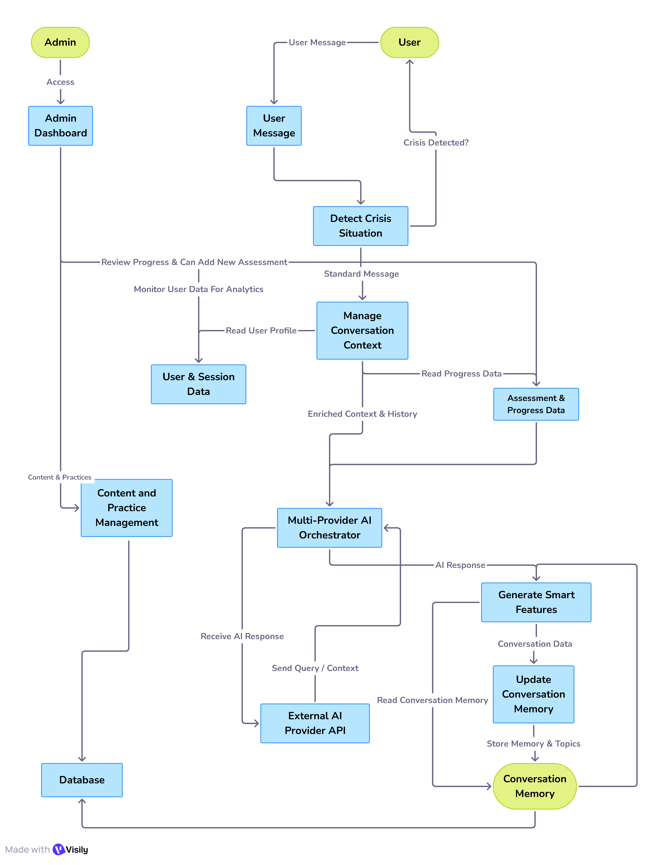
Data Flow Diagram
DFD Level 2:

Slide 14
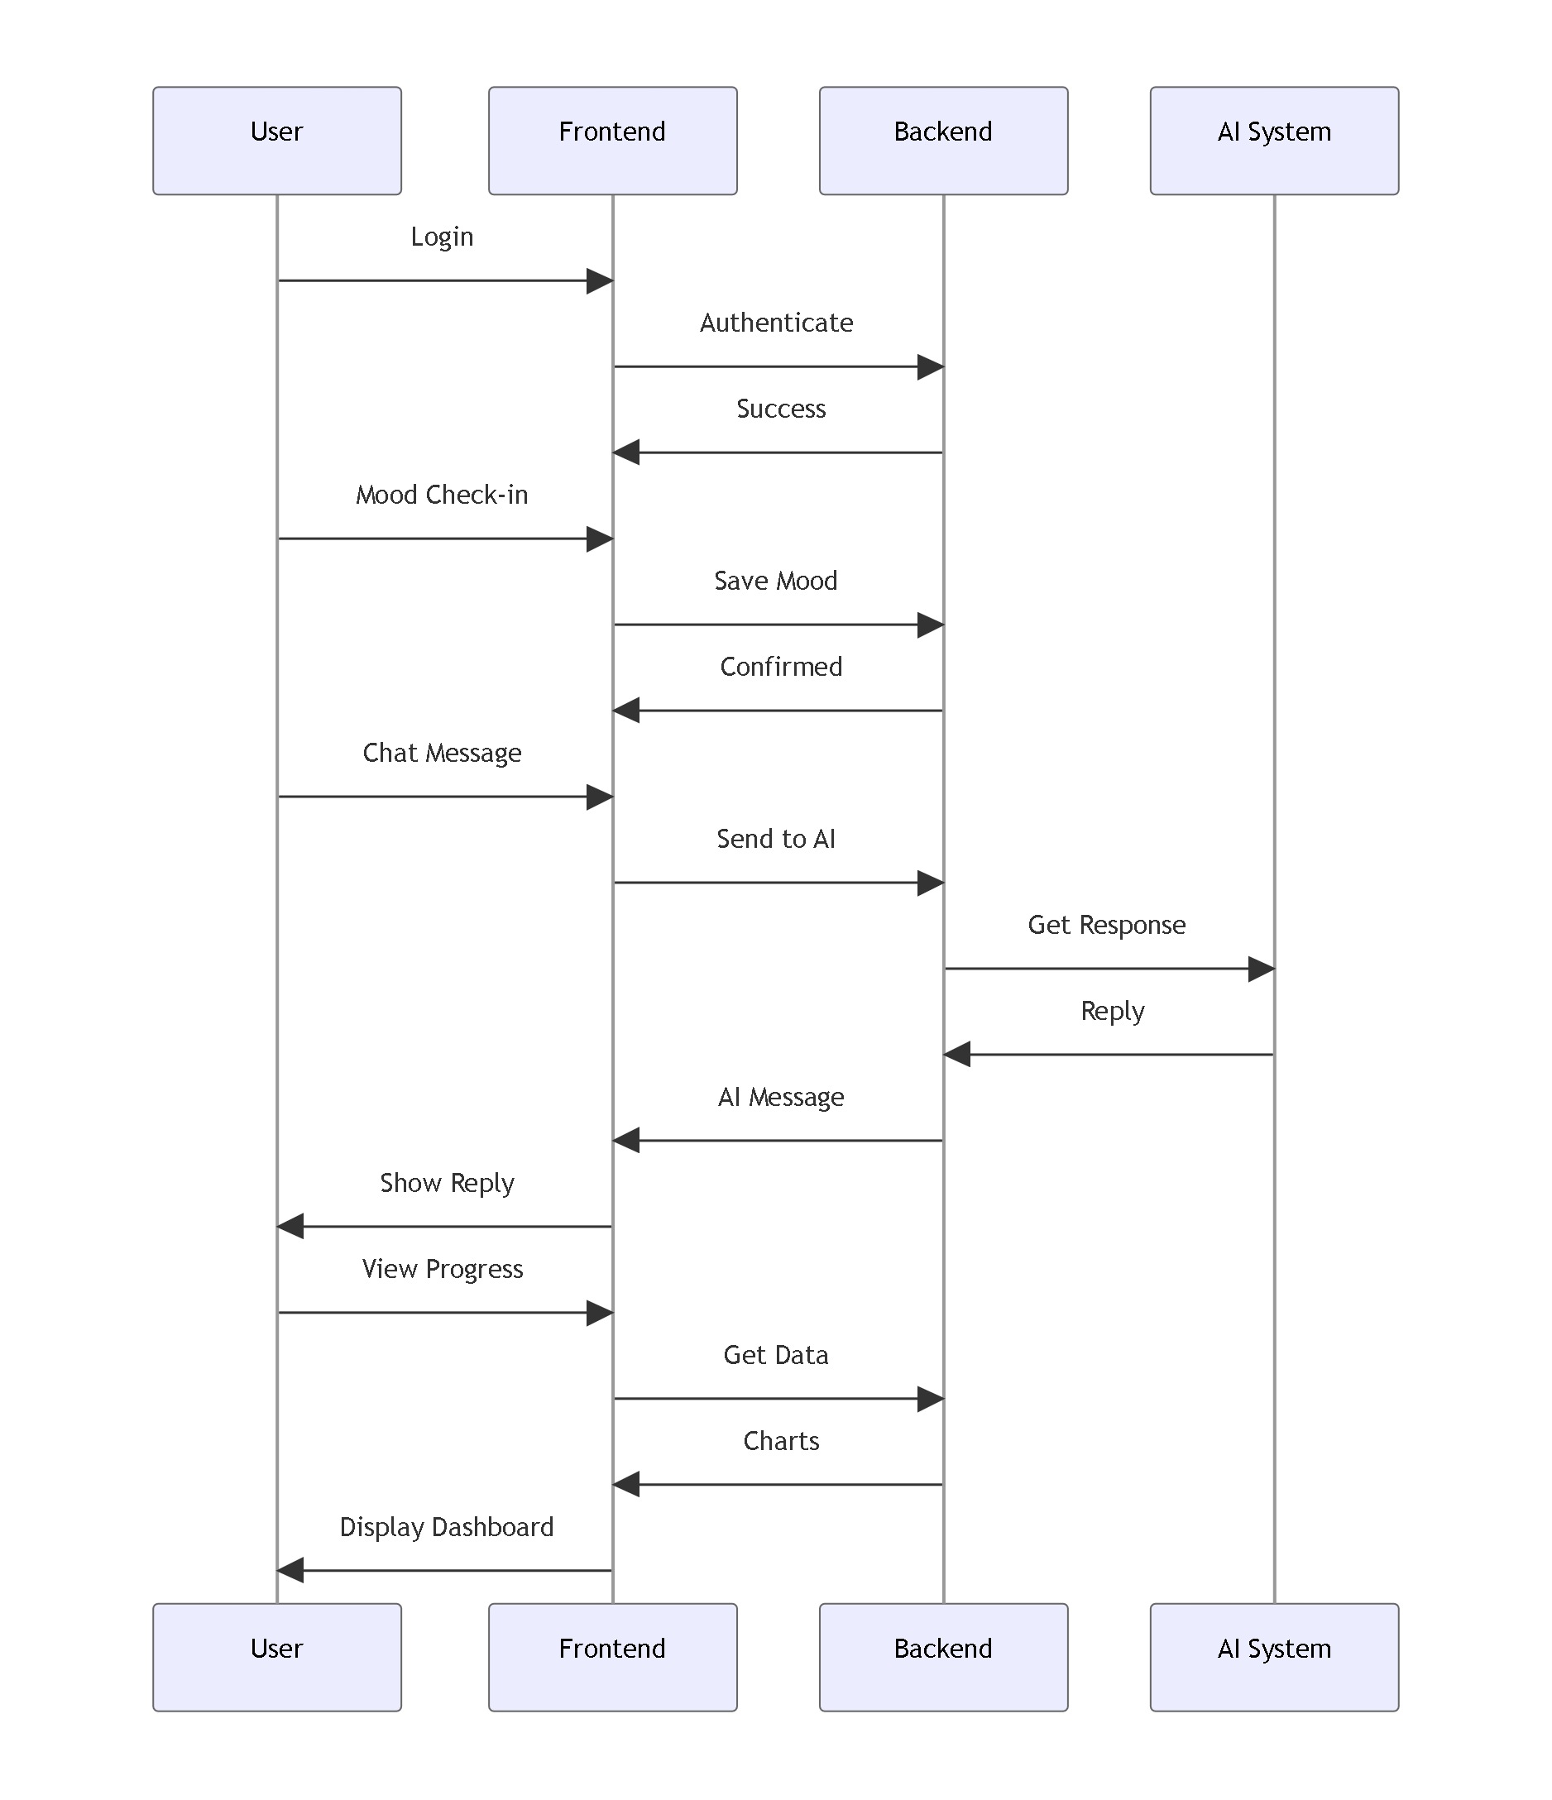
Sequence Diagram

Slide 15
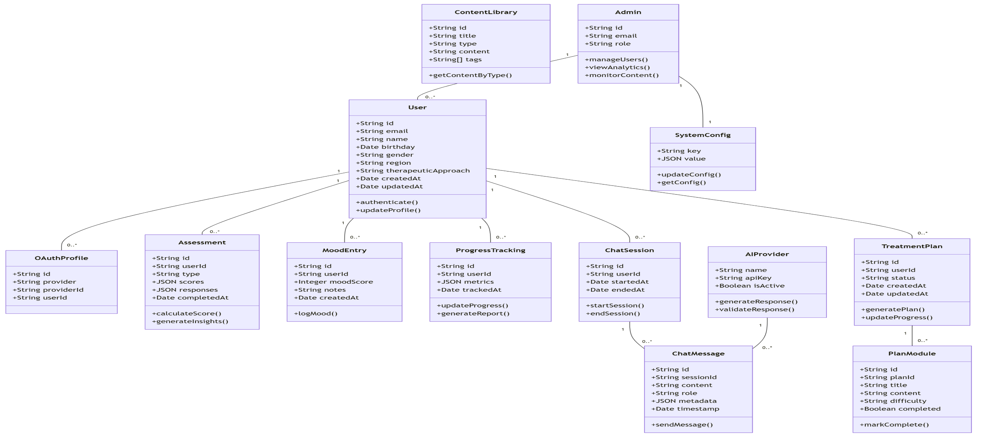
Class Diagram

Slide 16
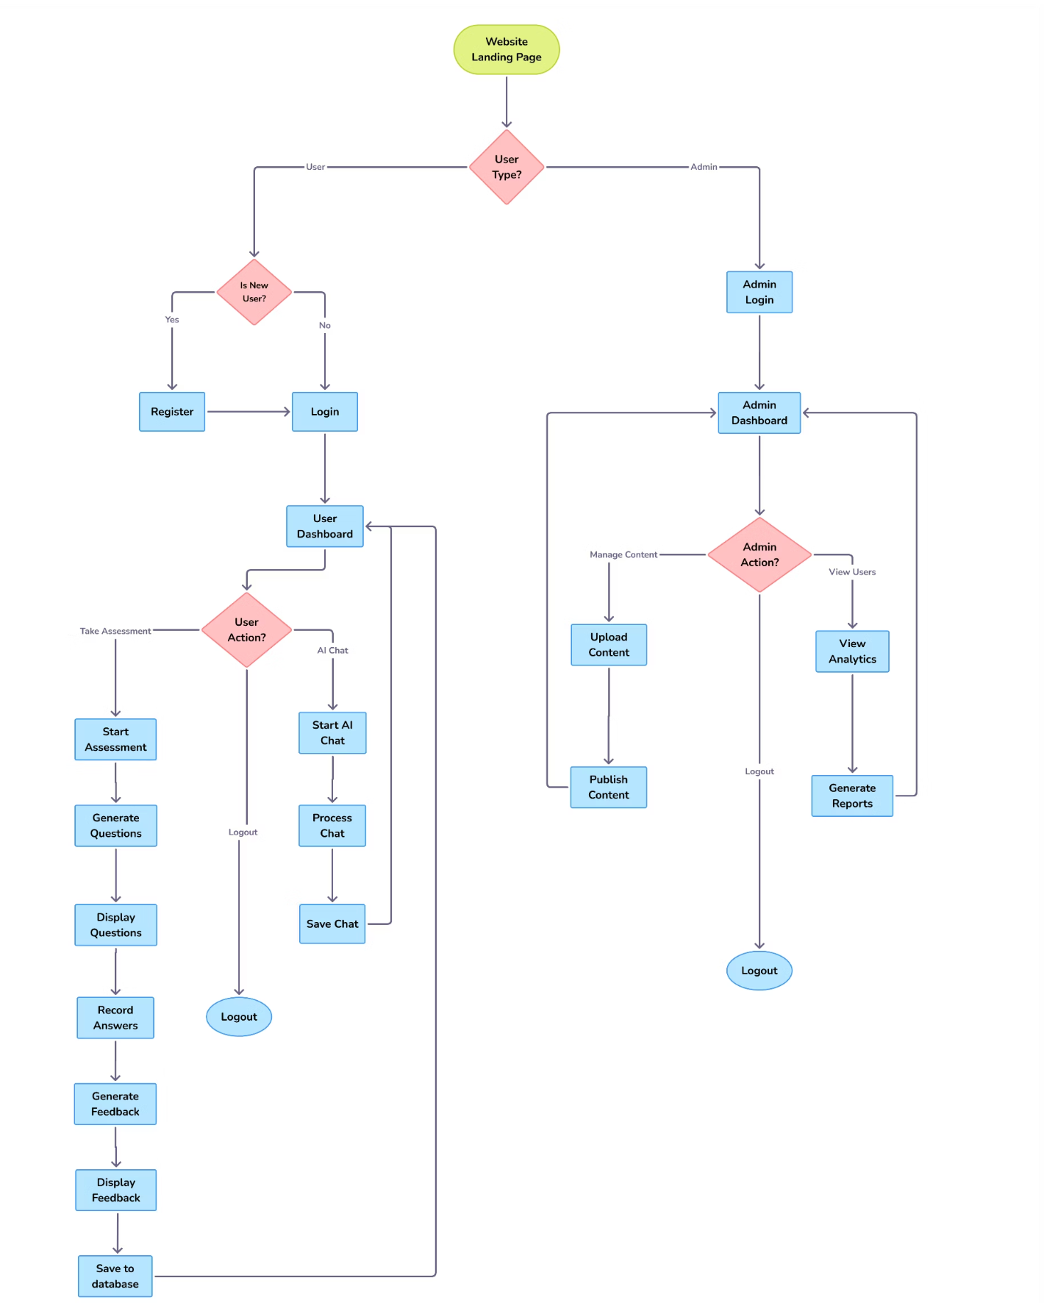
Activity Diagram

Slide 17
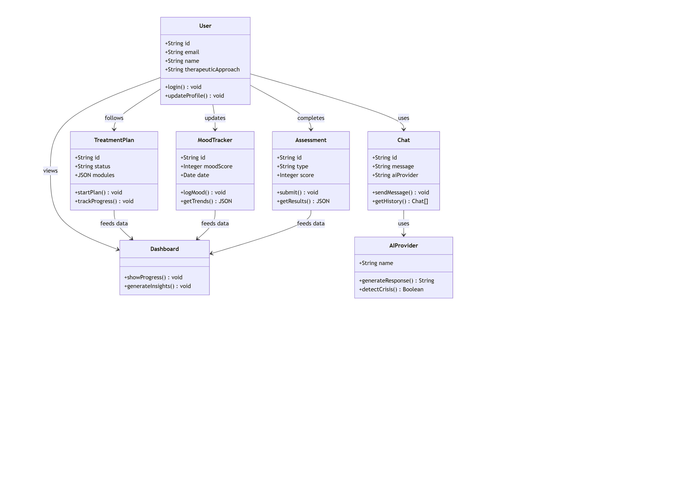
Unified Modeling Language.

Slide 18
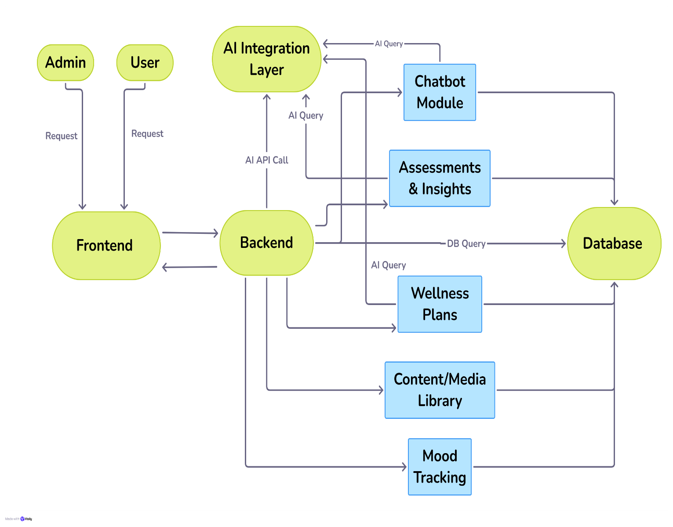
Architecture Diagram

Slide 19
SOFTWARE / HARDWARE
Software: Frontend: React 18 & TypeScript Backend: Node.js + Express AI: OpenAI API, Gemini API, Hugging Face API, Local machine LLM Database: Firebase / MongoDB / Prisma DB / SQL lite Hosting: AWS / Google Cloud / local host Content Storage: Cloud storage with API integration (YouTube API) Hardware: Mobile device (Android/iOS) Server infrastructure (cloud-hosted) Optional wearable integration for biometrics

Slide 20
PROJECT PLAN
Phase 1: Requirement gathering & research (2 weeks)
Phase 2: UI/UX design (3 weeks)
Phase 3: Core backend + AI integration (6 weeks)
Phase 4: Feature development (chatbot, tests, recommendations) (8 weeks)
Phase 5: Testing & feedback (4 weeks)
Phase 6: Deployment & monitoring (2 weeks)
Total: ~25 weeks (6 months) for completion.

Slide 21
Conclusion
Our Manasarathi AI Mental Wellness platform combines scientific therapy and ancient wisdom in a simple, accessible, and personalized platform. By delivering both emotional support and actionable guidance, it empowers users to take charge of their mental health anytime, anywhere.

Slide 22
References
Thakkar A., Gupta A., De Sousa A. (2024) – Artificial Intelligence in Positive Mental Health: A Narrative Review, Frontiers in Digital Health – DOI: 10.3389/fdgth.2024.1280235
Salcedo Z. B. V., Tari I. D. A. E. P. D., Ratsameemonthon C., Setiyani R. Y. (2023) – Artificial Intelligence and Mental Health Issues: A Narrative Review, Journal of Public Health Sciences, Vol. 2(02), 58-65 – DOI: 10.56741/jphs.v2i02.282 Ruiz-Vanoye J. A., Fuentes-Penna A., Barrera-Cámara R. A., et al. (2025) – Artificial Intelligence and Human Well-Being: A Review of Applications and Effects on Life Satisfaction through Synthetic Happiness, International Journal of
Laranjo, L., et al. (2023). "The Effects of an AI-Powered Chatbot on Mental Health.
Guo, Y., et al. (2024). "Large Language Models for Mental Health Support: A Systematic Review.
Calvo, R. A., et al. (2025). "Natural language processing in mental health applications using non-clinical texts.
22

Slide 23
References
Poria, S., et al. (2023). "A Survey on Sentiment Analysis and Emotion Recognition.
Halder, S. (2025). Developing mental health support chatbots in India: Challenges and insights. Annals of Indian Psychiatry,9(1),99-101.
Marade, A., Suvarna, K., Chaudhari, P., & Bhandiwad, V. (2025). Spiritual.AI: An AI- driven platform for enhancing mental, emotional, and spiritual well-being. International Journal for Research in Applied Science & Engineering Technology (IJRASET), 13(4),4211-4214.
Malviya, S. (2024). The need for integration of religion and spirituality into the mental health care of culturally and linguistically diverse populations in Australia: A rapid review. Journal of Religion and Health, 62, 2272–2296.
22

Slide 24
References
Casu, M., Triscari, S., Battiato, S., Guarnera, L., & Caponnetto, P. (2024). AI chatbots for mental health: A scoping review of effectiveness, feasibility, and applications. Applied Sciences, 14(13), 5889.
Aggarwal, S., Wright, J., Morgan, A., Patton, G., & Reavley, N. (2025). Religiosity and spirituality in the prevention and management of depression and anxiety in young people: A systematic review and meta-analysis. BMC Psychiatry, 23, 729.

